Slide 1
An Effective Approach for Routing the Bug Reports to the Right Fixers
Shengqu Xi
State Key Laboratory for Novel
Software Technology, Nanjing
University, China
xsq@smail.nju.edu.cn
Yuan Yao
State Key Laboratory for Novel Software Technology, Nanjing University, China
y.yao@nju.edu.cn
Xusheng Xiao
Department of Electrical Engineering and Computer Science, Case Western Reserve University, USA xusheng.xiao@case.edu
Notes:
第十届亚太网构软件研讨会会议(Internetware 2018)

Slide 2
01
Introduction & Background
02
Preliminary study
CONTENTS
03
Approach & Details
04
Conclusion

Slide 3
Introduction
Basic workflow in the bug tracking systems
Report a bug
Communicate and tossing
Fix the bug
Submit a bug
Manager chose a developer to fix
Communicate with reporters and other developers
Leave a comment below the bug report
Reassign the bug report
Bug will be tossed until fixed
The status is fixed or closed or verified

Slide 4
Introduction
Automatic bug triaging approaches
Adopts information retrieval techniques
Machine learning techniques
Construct the representations of bug reports and developers
Match the bug reports to the most related developers
Extract features or learning representations of bug reports
Treat the developers as labels
Deep learning techniques

Slide 5
Introduction
Two facts of automatic bug triaging problem
One developer will fix the corresponding bugs.
A tossing sequence will provide valuable information.
SeqTriage
Notes:
大约25%的开发者会修复他们相对应的bug report
一次再分配可以表明两个开发者的关系，同时也可以帮助我们确定或找到更合适的开发者

Slide 6
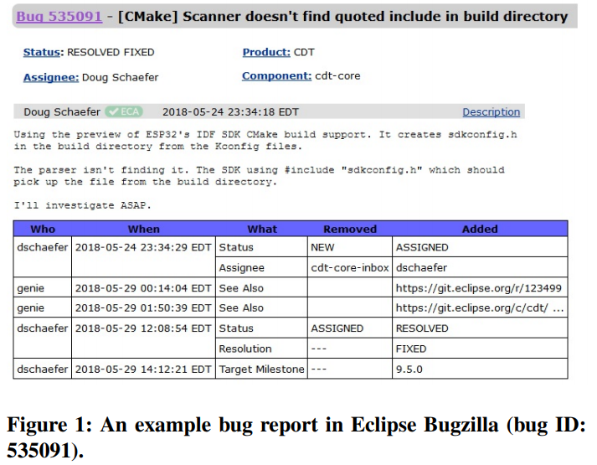
Background
Bug report and bug history

Slide 7
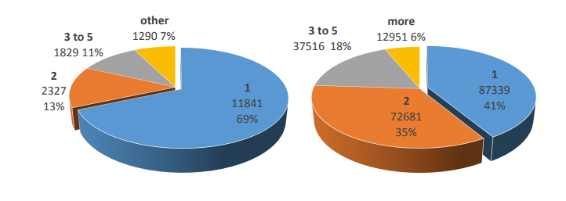
Preliminary study
Reporter locality and tossing sequence
Reporter locality: reporters tend to be focused on certain sub-areas of the project.
Tossing sequence: reduce the tossing sequence length can greatly reduce the bug fixing time.
Notes:
把product和component作为一个关键字进行统计

Slide 8
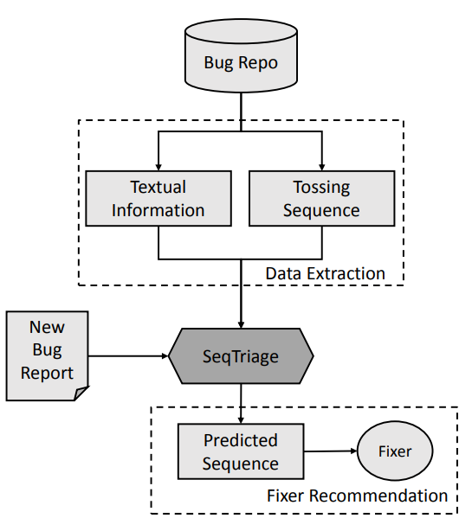
Approach: Seqtriage
Framework

Slide 9
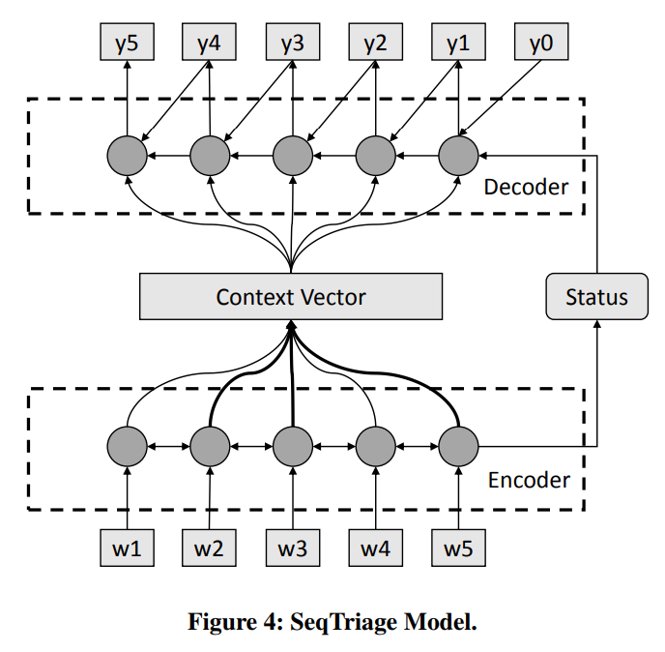
Approach: Seqtriage
Details of seqtriage
Notes:
双向RNN

Slide 10
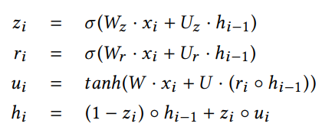
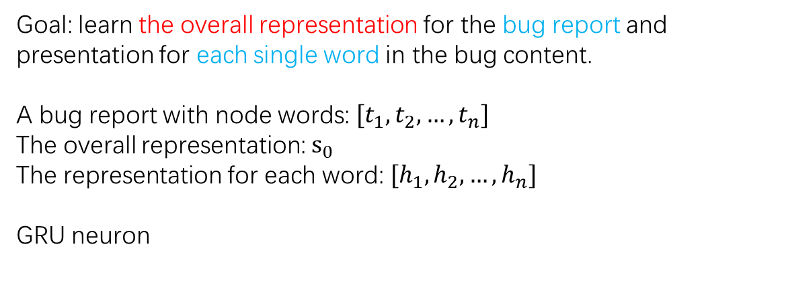
Approach: Seqtriage
Encoder component
Goal: learn the overall representation for the bug report and presentation for each single word in the bug content.
A bug report with node words: $[t_{1},t_{2},…,t_{n}]$
The overall representation: $s_{0}$
The representation for each word: $[h_{1},h_{2},…,h_{n}]$
GRU neuron
Output: 1. the textual representation for each word
2. the overall representation of the text
Notes:
GRU原理

Slide 11

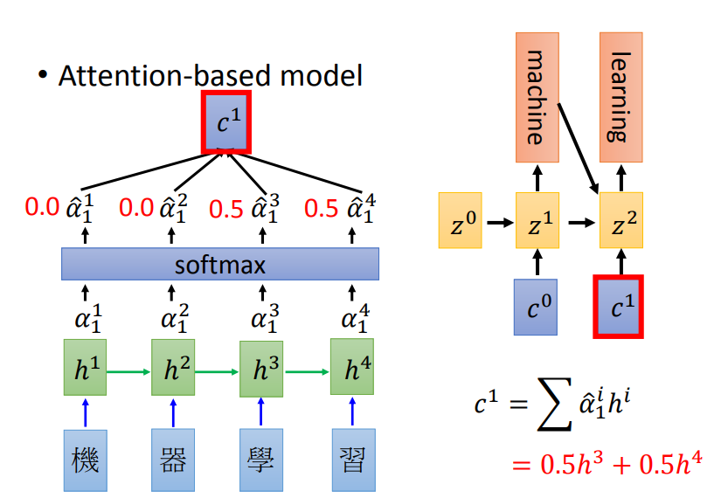
Approach: Seqtriage
Decoder component
Context vector c is different for different prediction target:

Slide 12

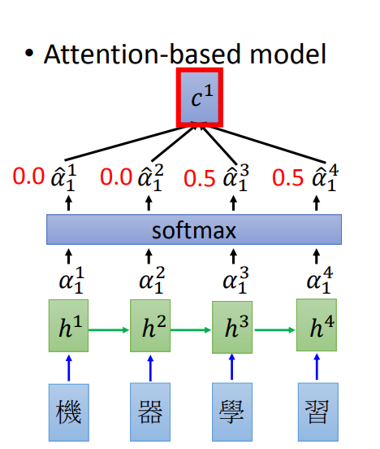

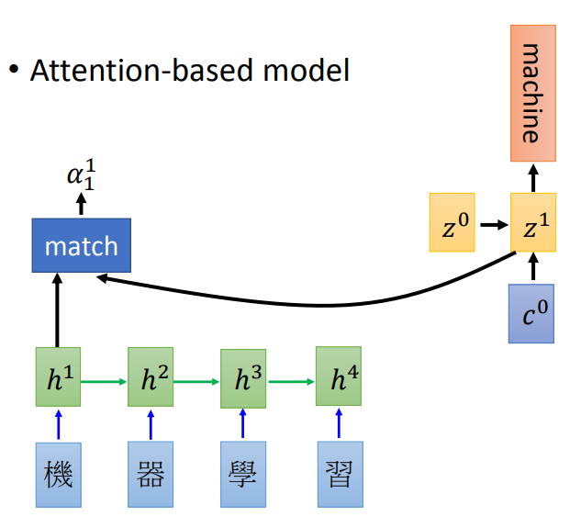
Approach: Seqtriage
Attention
When the decoder generates a single prediction, we first define the score of word i as
The attention weight $a_{i}$ for word i
Match

Slide 13
Research question
Can the proposed approach outperform the existing approaches in terms of bug triaging accuracy?
Is the reporter useful in bug triaging?
Are the other developers in the predicted tossing sequence related with the bug report?
Is the attention mechanism explainable when choosing different developers?

Slide 14
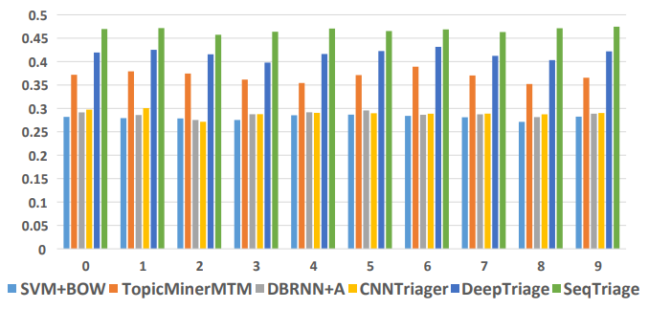
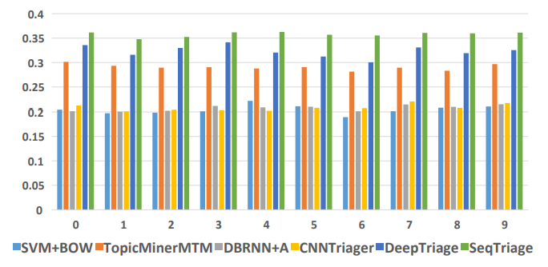
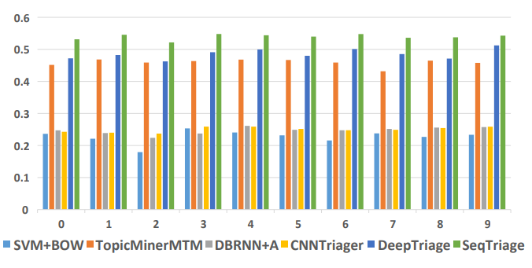
Research result
Can the proposed approach outperform the existing approaches in terms of bug triaging accuracy?
Eclipse
Mozilla
Gentoo
Notes:
SVM+BOW：使用tf-idf作为每个词的文本特征，应用svm把bug分派问题作为分类问题。
TopicMinerMTM：最先进的信息检索技术，应用主题模型学习缺陷文本的表示，并且整合product和component信息，最后计算bug和开发者的相似性
DBRNN+A：使用RNN和Attention模型学习文本表示，直接增加softmax层推荐开发者
CNN triage：与DBRNN+A相似，只是用CNN来学习文本表示
Deeptriage：基于RNN学习文本内容，并且考虑开发者的活跃程度

Slide 15
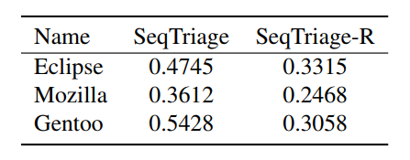
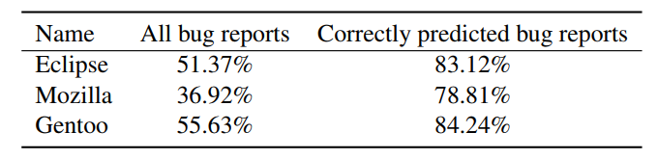
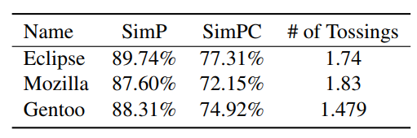
Research result
2. Is the reporter useful in bug triaging?
3. Are the other developers in the predicted tossing sequence related with the bug report?
Notes:
开发者更倾向于向修复相同的product的bug report

Slide 16
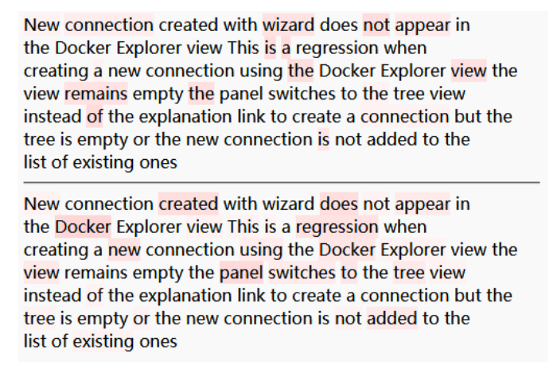
Research result
4. Is the attention mechanism explainable when choosing different developers?
jjohnstn
xcoulon
Notes:
将此bug分配给两个人，jjohnstn和“xcoulon”，发现j主要关注的是wizard和view，也就是UI的部分，而x关注的是Docker，create和panel

Slide 17
Threats to validity
For the ground truth of the suitable fixer, we follow the previous approaches to select the “Assignee”.
Filter out the developers who have fixed less than 10 bugs. It is possible that these developers would fix the future bugs.
We have crawled and analyzed three open source projects. However, open source projects might be different with industry projects.

Slide 18
Conclusion
In this paper, we propose a novel approach, SeqTriage, motivated by two important facts observed in the bug triaging problem: reporters as the fixers and the tossing sequences formed by a sequence of related developers.
SeqTriage adopts a sequence to sequence model to predict a sequence of developers as potential fixers.
SeqTriage uses the reporters as the initial token in the model, increasing the probability to predict the reporters as the fixers.
We evaluate SeqTriage on three open-source projects, and the evaluation results show that SeqTriage improves the accuracy of the bug triaging compared with the state-of-the-art approaches

Slide 19
An Effective Approach for Routing the Bug Reports to the Right Fixers
黄金筱 2019.3.23

